Slide 1
#ResearchThatMatters
The Size, Scope, and Effectiveness of Community Corrections:
A Global Review of Research

Slide 2
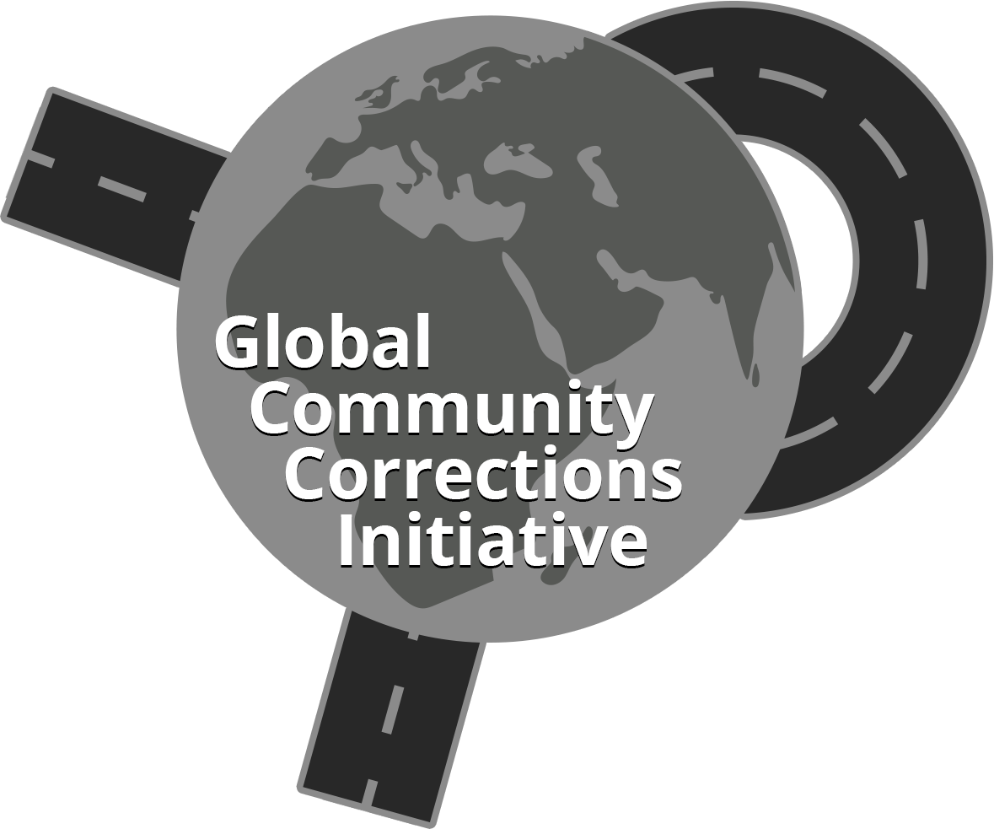
the Size, Scope, and Effectiveness of the Global Community Corrections System
James M. Byrne, Director, Global Community Corrections Initiative
Professor Emeritus
School of Criminology and Justice Studies
University of Massachusetts Lowell

Slide 3
Some Questions to Consider about the size, scope, and effectiveness of the Current Community Corrections System
How many individuals are under total correctional control—both in carceral settings and in community corrections—globally?
Is there intra-regional and/or inter-regional variation in the relative size of the Prison and Community Corrections population globally?
Do Countries with the largest prison populations also have large community corrections populations?
What do we know about the effectiveness of community corrections?

Slide 4
The Size OF THE GLOBAL CORRECTIONS POPULATION
We were able to find data on the size of the community corrections system for 28 of the 50 countries with the largest prison populations, where over 90% of global prison population are located
The mix of carceral and community corrections in these countries suggests that the size of the global corrections population is currently close to 24 million, with 11.5 million people in the prison system (i.e., 48% of the estimated total) and 12.5 million individuals in the community corrections system (52% of the estimated total corrections population).

Slide 5
how many individuals are under total correctional control—both in carceral settings and in community corrections—globally?
The size of the global corrections population is currently close to 24 million:
11.5 million people in the prison system (i.e., 48% of the estimated total) and
12.5 million individuals in the community corrections system (52% of the estimated total corrections population).

Slide 6
Is there regional variation on the relative size of the Prison and Community Corrections System?
Some minor Intra-regional variations in the relative size of the prison and community corrections system were identified.
Countries in three global regions—South America, Asia, and Africa—with large prison systems appear to prioritize carceral control over community-based alternatives
Countries with equally large prison systems located in three other regions—North America, Europe, and Oceana—have built systems with greater community corrections than carceral capacity.

Slide 7
Do Countries with the largest prison populations also have large community corrections populations?
Close to 60% of the Global Prison Population is located in just 10 countries: USA, China, Brazil,India, Russian Federation, Türkiye, Indonesia,Thailand, Mexico, and Iran
We can only estimate the community corrections populations in 7 of the top 10 largest prison systems globally ( missing data for Brazil, Mexico, and Iran).
In these top 10 countries, the prison system is larger than the community corrections system in 5 of the 7 (top-10) countries.
Exceptions:
United States, whose community corrections system was 2.1 times larger than its prison system
Russian Federation, whose community corrections system is marginally larger than its current prison population.

Slide 8
What do we know about the effectiveness of Community-based Sanctions?
Available Measures of Probation Effectiveness
compliance with probation conditions, and
evidence of desistance from crime, either while under supervision or post-release.
Using these outcome measures, many probation systems were identified with high compliance rates, and several were also effective in limiting re-offending while the individual was under supervision.
Measures of Parole Effectiveness
data on the effectiveness of parole systems was harder to find. For countries that provided data, significant variations in parole completion rates, re-arrest rates, and return to prison rates were identified.

Slide 9
An Overview of the Global Community Corrections Initiative
Goal: To advance community corrections practices throughout the world through a myriad of directive activities to create global awareness of community corrections at the pre-trial, sentence, and reentry stages of the criminal justice process.
Step 1: Create a global community corrections website https://globcci.org/about/
Step 2: Identify key global partners and resource experts
Step 3: Collection of Country-level community corrections data
Step 4: Collection of research studies on the effectiveness of community corrections in each global region
Step 5: Knowledge Dissemination via presentations, webinars, books, and journal articles

Slide 10
Building a Global Data Base: An Overview of our work in each global region
For details on our global data collection efforts, go to our website: https://globcci.org/country-profiles/
Country profiles have only been completed for a small number of countries in each global region, but we are actively recruiting country-level community corrections experts.
A listing of experts in each region is found in our regional overview link.
Examples of completed country-level profiles of community corrections are currently available for United Kingdom, South Korea, Ireland, Israel, Kenya, and South Africa

Slide 11
Recent work from the Global Community Corrections Initiative
For more information on how to become a country-level expert and join our Global Initiative, contact James Byrne, the Project Director, at profbyrne7@gmail.com

