Slide 1
"How to Improve" the Psychology of Criminal Conduct (PCC) and Risk-Need-Responsivity (RNR) Frameworks
Fourth International Correctional Research Symposium 2025
Faye S. Taxman, Ph.D.
University Professor
George Mason University
ftaxman@gmu.edu
Acknowledgements: Appreciation to the ICPA for their support and to the National Institute of Health—The National Institute on Drug Abuse’s Justice Community Opioid/Overdose Innovation Network (JCOIN) (U2C DA050097, MPI Taxman & Rudes) and the National Institute of Mental Health Evaluation of Stepping Up (R01 MH118680, Taxman & Johnson). Key people: Dr. Ben Mackey, Dr. Danielle Rudes, Dr. James Byrne.

Slide 2

PCC/RNR: Transformative
PCC/RNR offered competing goals of deterrence, incapacitation, and rehabilitation (maybe some retribution)
Institutional and Community Corrections could embrace rehabilitation goals, mixing punishment, treatment, and deterrence
3 grandiose ideas (theoretically and conceptually sound)
  Risk should drive the intensity of the correctional incarceration or supervision
  Need should drive “what is done” (i.e. type of conditions, requirements) with an emphasis on eight areas
  Responsivity should be individualized to the unique needs of a person (i.e. literacy, trauma, motivation, readiness to change) with an emphasis on social learning strategies
3 impracticalities given the state of our (soft and hard) technology
  Most officers are not clinically trained
  Most agencies are low-resourced
  Corrections/probation is part of the punishment system which typically overrides rehabilitation ideals

Slide 3

Risk-Need Assessment Tool: (some) State of the Art
Major push involving PCC/RNR with emphasis on using a tool to screen and assign appropriate treatment programs.
Little attention to the intensity of supervision (to ameliorate risk)
Tool designs vary but generally…
  Risk generally means the number of bits at the CJ apple, not public safety threat
  AUC (validation) is low
  Scales are not well-designed (poor Cronbach’s alpha, poorly constructed scales, meaningless definition of scales which are not tied to interventions)
    Social stability factors are not considered in the equation of dynamic risk, even though housing, transportation, food security and mental health affect functionality. Officers must address these issues to achieve successful outcomes. Lacks emphasis on strengths/agency.
  Few agencies have guidelines on how to use the Risk and Need Scores
  Few agencies link to programs/services/punishment
Officers lack confidence in the tools, as they tend to be used for cookie-cutter approaches rather than individualized ones.

Slide 4
Criminal Justice and Behavior, 42(3): 263-286
Misalignment in Supervision:
Implementing Risk/Needs Assessment Instruments in Probation
Jill Viglione, Danielle S. Rudes, Faye S. Taxman
Qualitative study of Officers use of RNA
Agency: Used instrument for over 10 years, multiple trainings
Findings
  Some officers “prefilled out the instrument” based on their knowledge of the client, including the Likert scales (degree to which is an issue)
  Some officers had the clients complete the instrument and never looked at the results
  Officers did not find the items in the RNA tool useful
  For low risk offenders, overrides routinely occurred for sex offenders, drunk driving offenses, and other “high stake” offenses
  For women offenders, officers protect women through increased risk level to get services
  Overall, officers did not understand the risk information
  General confusion regarding domains of criminal thinking and errors

Slide 5
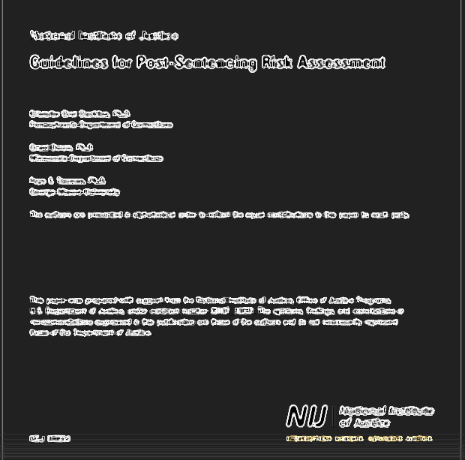
RNR Unanswered Questions
3rd and 4th generation RNA tools (w/criminogenic needs)
  Varied, inconsistent measurement of criminogenic needs
  Added criminogenic needs do not improve the predictive validity
  or performance
  Tools have increased in complexity without increased precision
Tools are often used in a variety of ways—many are not tested
The science of instrument development is messy
  Unclear or non-existing standards
  Various quality of different scales
  Many instruments have lower than desired AUC levels
  Racially and gender neutral tools?
  Variable methods with variable outcomes (new kid is machine learning)

Slide 6
How effective is RNR (PCC)?
Few studies test the full framework: Risk+Reed+Responsivity (Fazel, et al, 2024)
Risk (high versus low risk) had the greatest amount of support
Need varies by instrument and condition
Few test of responsivity
General responsivity (social learning environment) appears supported
Specific responsivity has too few studies
Has RNR reduced recidivism or improved outcomes?
Poor implementation
Risk instruments do not measure “risk” (in terms of violence, public safety, etc.)
Needs are poorly measured and therefore don’t differentiate between lifetime and current
Responsivity is not measured
The ‘gut’ is missing in that line staff do not have confidence in the approach
Fazel, S., Hurton, C., Burghart, M., DeLisi, M., Ronggin, Y. (2024). An updated evidence synthesis on the Risk-Need-Responsivity (RNR) model: Umbrella review and
commentary, Journal of Criminal Justice, 92: https://doi.org/10.1016/j.jcrimjus.2024.102197.

Slide 7
Challenges: Failure to Meet the Promise
Challenge 1: Staffing of correctional agencies
Challenge 2: Practice Frameworks are under (or never) utilized
Challenge 3: Modernize and update the RNR/PCC models with new scientific information and practical realities

Slide 8
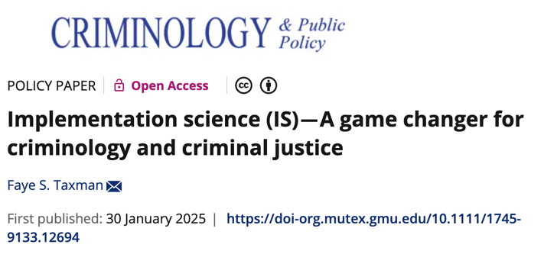
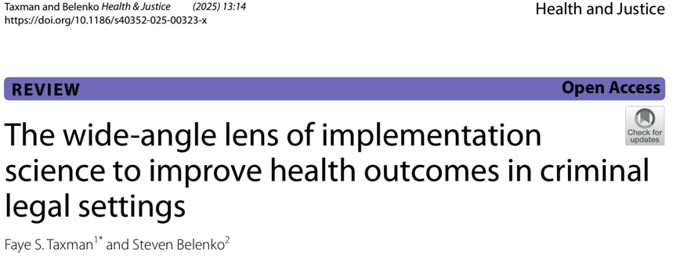
Implementation Science: A Tool for Addressing the Achilles Heal of RNR Implementation

Slide 9
Implementation Science
Emphasizes Transportability
Transportability is the process of identifying how to align or fit an EBP to your environment (adaption, not replication)
What shapes do innovations/EBPs take?
  Scientific Robustness of the research to support the approach in terms of target population, settings, organizations
  Characteristics of Innovation/EBP that are implemented: what, why, and how much? and core features emphasized
  Inner Setting—staff agreement, organizational culture, management supports
  Outer Setting—stakeholder supports, resources,
  messaging, mission/goals
Inner
Setting
Outer Setting
EBP
Process

Slide 10
Challenge 1: Staffing of correctional agencies

Slide 11

Implementation Affects RNR Utilization
State of Practice
Staff often do not view themselves as professional or have the skills to be a semi-”clinician”
Staff do not understand risk-need assessment tools
  The tools are deficit-focused and lack key traits that affect success such as mental illness, housing, stability, etc.
  The tools do not deal with public safety risks
  The tools fail to address crime severity
  The needs components are poorly understood
Implementation is usually done through a top-down approach
Training focuses on ”what to do”, not “how to” or “why”
Empowering Staff and Organizations
Culture that Embraces Responsivity or Client-Centered Approaches
Learning Environment
Risk Taking
Attention to Resource Deprivations

Slide 12
What do we know about successful reforms?
Quality Improvement Processes
Plan_Do_Study_Act helps to get staff processes
Data driven decision making
Focuses on process and outcome issues
Organizational Accountability
Focus on procedural justice
External Facilitation
Provides tools to achieve better work products
Allows for co-production
Empowers agencies to address common problems (Magnuseon, et. al., 2019)
Identifies key metrics of success
Can be used to drive change decisions to improve practice
Articulates what decisions are grounded in justice
Participates in evaluations
Serves to increase legitimacy
External facilitators have the “time” and knowledge to manage projects
Improves productivity
Reinforce how RNR results are used in case plans.
Relationships are key
Value this as a core element
Tie into the metrics
Acknowledge this is an important feature of RNR

Slide 13
Challenge 2: Practice Frameworks are under (or never) utilized

Slide 14
Practice Frameworks (Policy Guidance)
Standard Operating Procedures tell what to do but not why
SOPs don’t deal with the operational procedures that are barriers to implementation
More attention is needed to defining
  What the research says (plain language)
  Where is the work process should this occur
  How to use it
  Perspective on staff, justice involved individuals, stakeholders
  Communications—how to address difficult issues
  Other items—definition of key terms, etc.
Reduce harms through variation in officer response
Adherence to RNR/CPP can be achieve through clear guidance

Slide 15
Practice
Contacts
In-Person Contacts
Telephone Contacts
Kiosk Contacts
Compliance-Based Practices
Employer Contacts
Collateral Contacts
Drug Testing
Electronic Monitoring
Phone-Based Monitoring
House Arrest
Restraining Orders
Financial Restrictions
Treatments
Substance Use Evaluation
Mental Health Evaluation
Cognitive-Behavioral Therapy
Alcohol & Drug Use Education
In- or Out-Patient Treatment
Motivation Techniques
Sanctions
Incentives
Pro-Social Modeling
Additional Components
Transportation Resources
Environmental Restructuring
Research Support
Evidence-Based*
Promising
Promising
Inconclusive
Inconclusive
Evidence-Based*
Inconclusive
Promising
Promising
Inconclusive
Inconclusive
Evidence-Based*
Evidence-Based*
Evidence-Based
Not Evidence-Based
Evidence-Based
Not Evidence-Based
Evidence-Based
Evidence-Based
Promising
Evidence-Based
Field Support: Probation Staff
Low Risk | Med/High Risk
Moderate | Wide
Moderate | Moderate
Moderate | Minimal
Minimal | Moderate
Moderate | Wide
N/A | N/A
Minimal | Moderate
Moderate | Moderate
Minimal | Moderate
Moderate | Moderate
Moderate | Moderate
Moderate | Wide
Moderate | Wide
Moderate | Wide
Moderate | Moderate
Moderate | Wide
Minimal | Moderate
Moderate | Wide
Moderate | Wide
Moderate | Wide
Moderate | Wide
Mackey, B., Appleton, C.J., Skidmore, S., Lee, J., & Taxman, F. S. (2022). At the intersection of research and practice: Constructing guidelines for a hybrid model of community supervision. Aggression and Violent Behavior, 63, 1359-1789 https://doi.org/10.1016/j.avb.2021.101689.

Slide 16
Example of Appropriateness Statement: Collateral Contacts
Risk Level | Research Support | Probation Support | JSI Support
Low | Inconclusive | Moderate | Minimal
Medium/High | Inconclusive | Wide | Moderate
Example Options to Consider:
Whether to use on Low Risk
Whether to use on Med/High Risk
Use only in situations when the person has unstable housing or employment
Limit address and employment contacts to once a year
Notes:
Ben
Present as options are sample of things to consider

Slide 17
Example of Appropriateness Statement for Substance Use Evaluations
Risk Level | Research Support | Probation Support | JSI Support
Low | Evidence-Based | Moderate | Moderate
Medium/High | Evidence-Based | Wide | Moderate
Example Options to Consider:
Use when individuals test positive for drugs or discuss illicit drug use
Use an evidence-based screener in the supervision agency
Refer individuals to clinical assessment if they screen positive
Do not use the evaluation as a sanction
Notes:
Ben

Slide 18

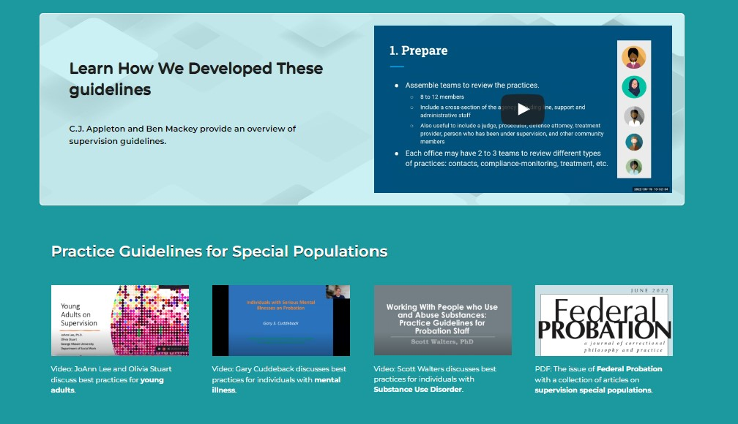
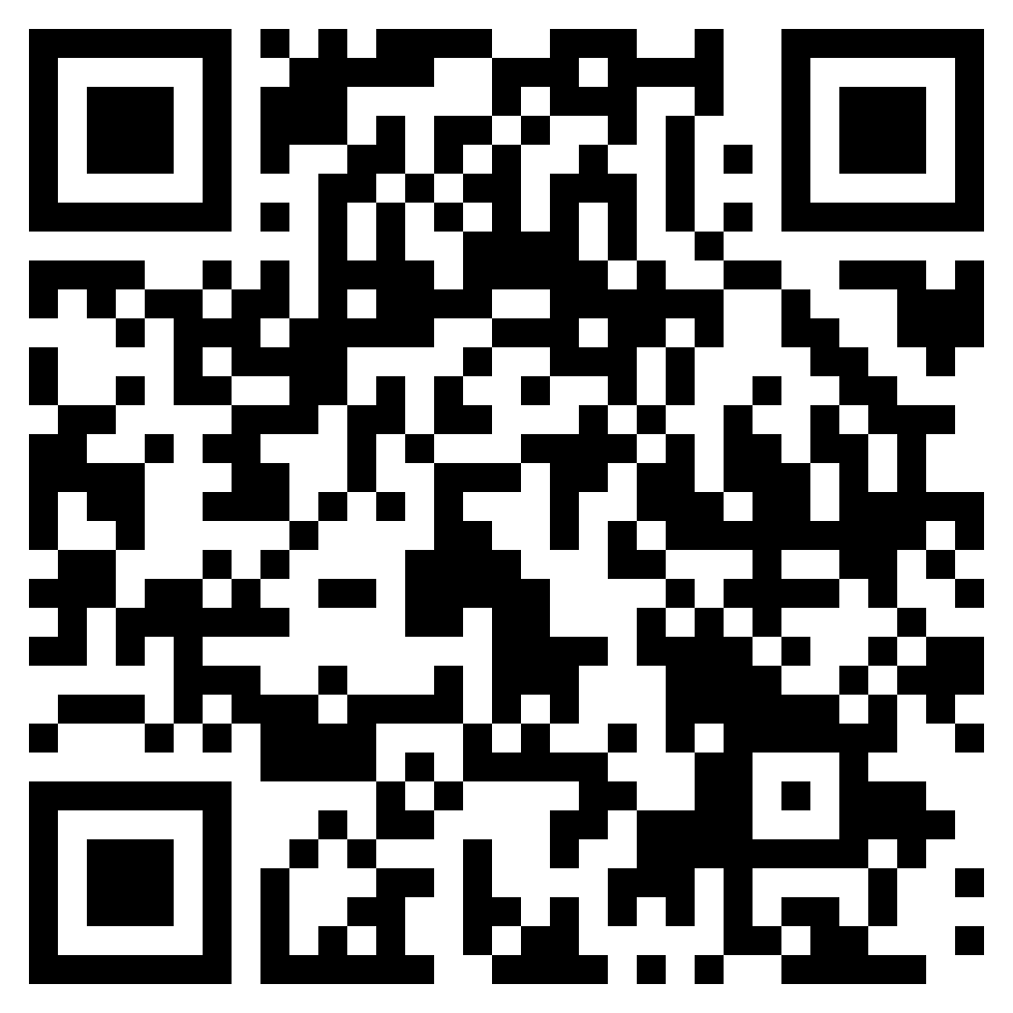
The Appropriateness Statements Package
Access Here!
gmuace.org/appropriateness-statement-package
Notes:
Ben

Slide 19

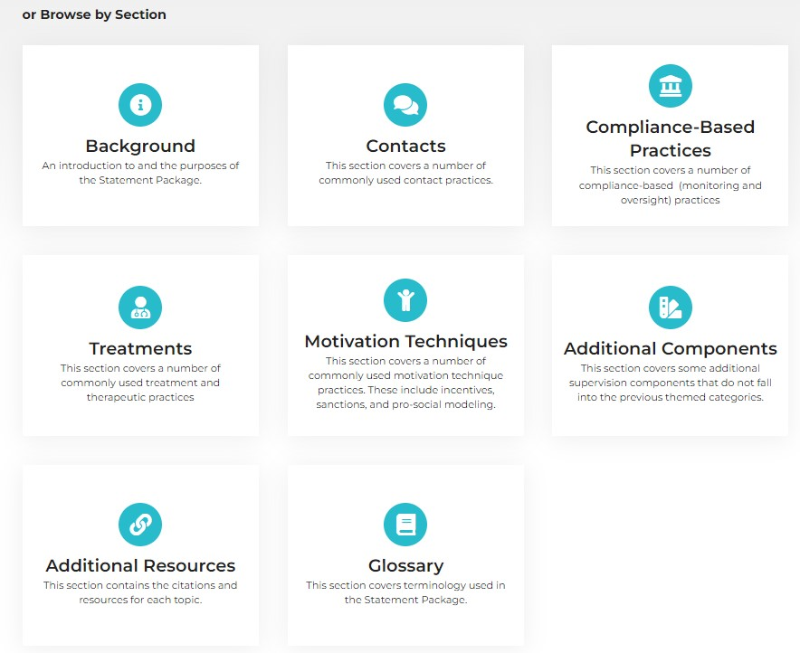
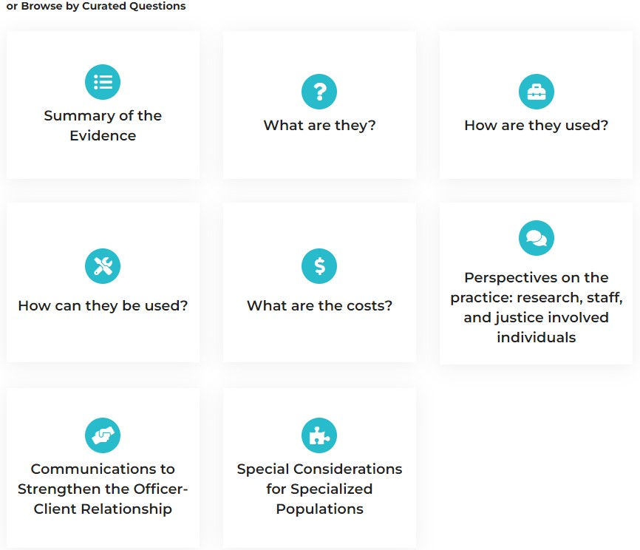
Searching Appropriateness Statements
Access Here!
gmuace.org/appropriateness-statement-package
Notes:
Ben

Slide 20
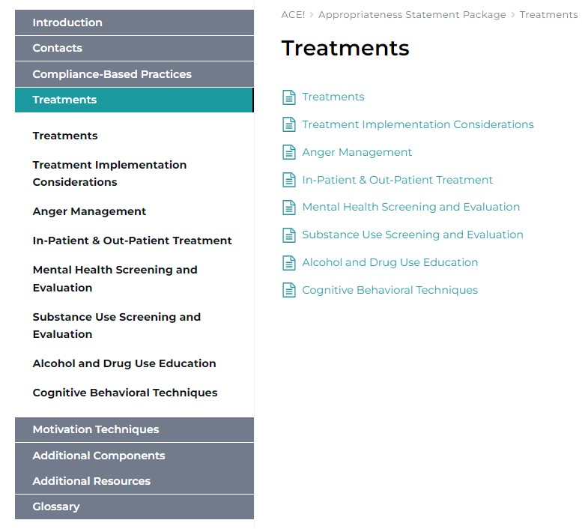
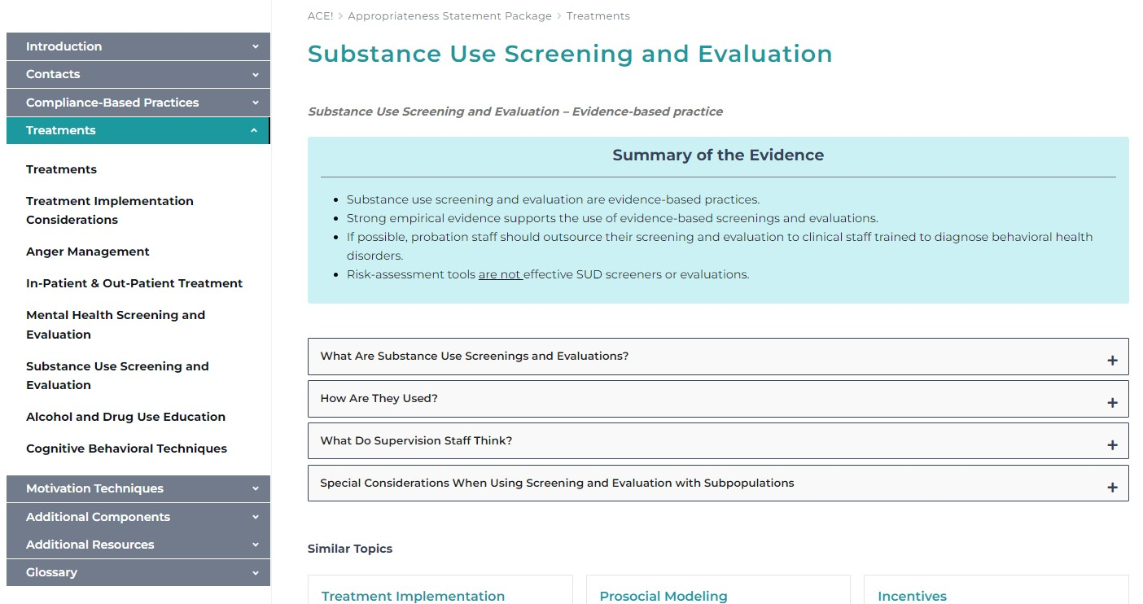
Using Appropriateness Statements
Access Here!
gmuace.org/appropriateness-statement-package
Notes:
Ben

Slide 21
Challenge 3: Modernize and update the RNR/PCC models with new scientific information and practical realities

Slide 22
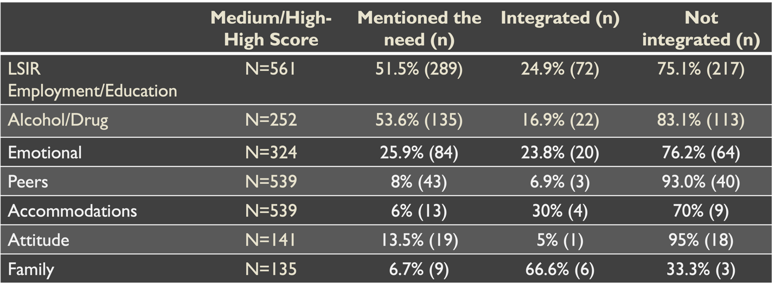
Fidelity : Consistency between RNR & case plan
Overall, there was little integration of needs within case plan strategies
Employment/Education (n=561): 24.9%
Substance Use (n=252): 16.9%
Emotional/Mental Health (n=324): 23.8%
Accommodations (n=539): 30.0%
Attitude and Orientation: (n=141): 5.0%
Family: (n=135): 66.6%
Thurman, T., Chowdhury, S., & Taxman, F. S. (2019). Fidelity measures for Risk Need
Assessment (RNA) tools usage in case plans. Corrections, 6(5), 383-399.
https://doi.org/10.1080/23774657.2019.1696252

Slide 23
Program Needs based on System Capacity to Provide Needed Services
Taxman, F.S., et al., 2019. The New York City RNR Gap Analysis Project. Fairfax, VA.
https://criminaljustice.cityofnewyork.us/wp-content/uploads/2020/10/MOCJ-ATI-RNR-Report-2019.pdf
Notes:
NOTES:
Needs rounded to nearest Hundredth
CIRT Capacity not included
Capacity for UYA BronxConnect (Life Skills programming) put under ”No formal programming”

Slide 24






Social Determinants of Health are Not Integrated into RNR
Work encourages taking on responsibilities and engages in productive activities
Community provide with social capital which ensure they see themselves as part of society
Health (Physical Activity) provides self-confidence, experience of success, emotional and psychological development.
Education focuses on providing opportunities for learning and implementing new skills
Relationships give a sense of belonging, and shape their behavior
Participation in Creativity (dance, theater, poetry) give competence and prosocial association with others
Work to develop the two core assets with these six domains and practitioners can design interventions and construct outcome measures.
Butts et al., 2010
Notes:
Butts and colleagues (2010) then recommended six practice domains (areas youth can/should focus on to get them on the right track) in which juvenile justice system could work to develop the two core youth assets (Butts et al., 2010). With these six domains, practitioners can design interventions and construct outcome measures. The six domains are: 1) Work; 2) Education; 3) Relationships; 4) Community; 5) Health, and 6) Creativity. For examples of aligning small steps, larger goals and Butts’ six practice domains please refer to Appendix P.

Slide 25
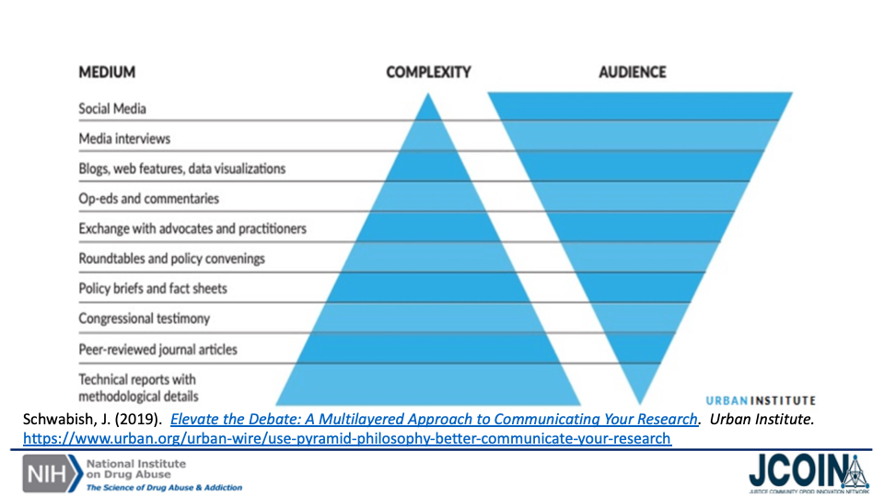
Source for Research Practice
Consider:
  Reach
  Messaging
  Partnerships
Expanded audiences, targeting all levels (front-line to managers)
”Touch” with researcher accelerates use of research findings
25

Slide 26
Next Generation of RNR To Address Research & Practical Realities
Risk for Violence
IPV
Social Determinants
Physical Health
Social Productivity
Relationships
Violent Behaviors
Psychosocial Health
Housing
Finances/Employment
Social Supports
Creativity
Role
CJ Involvement
Number of Convictions
Type of Offense(s)

Slide 27
Revised RNR Framework
New Principles of RNR
Community capacity should be considered in quest for appropriate services
Risk should focus on public safety/violence, not number of involvement
Needs should focus on strengthening protective factors; addressing MH, SUD, violence-prone issues
Needs should recognize that stability must be attained before risk reduction occurs
Responses—programs, services, controls—should be tailored to the individual
Organizations should promote social learning strategies for staff and clients
Organizations should be research-friendly with routine updates on “what we know”
Community Capacity (which programs are available?)
Criminal Justice Risk with emphasis on Violence
Protective Factors—housing, relationships, community involvement
Health with emphasis on MH and SUD care; address physical health nees

Slide 28
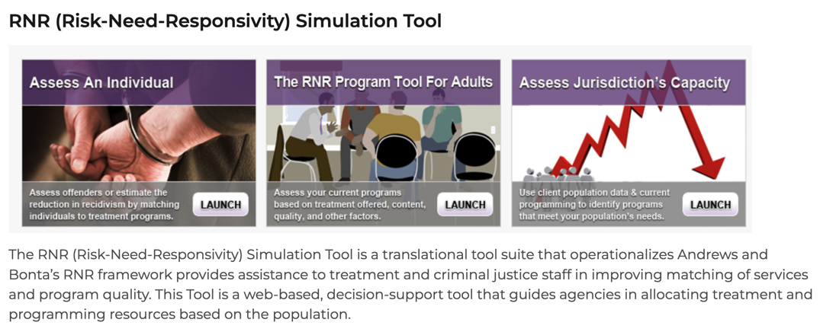


Check Out Some Tools of the Trade!
https://www.gmuace.org/major-projects/rnr-simulation-tool/
https://www.jcoinctc.org/courses/leap-learner-implementation-science/
https://www.gmuace.org/appropriateness-statement-package

Slide 29
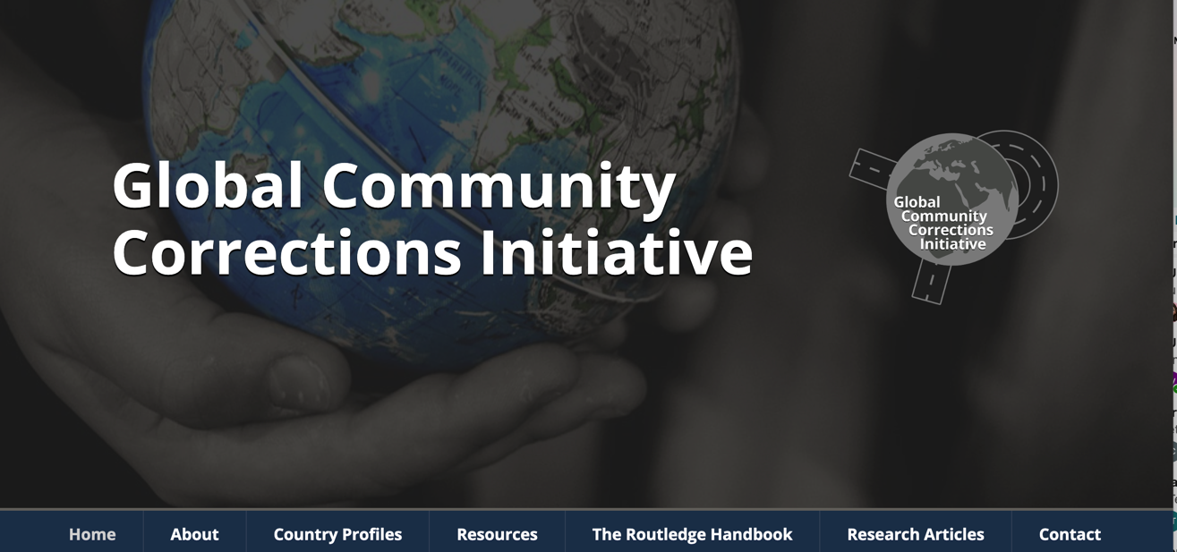
https://globcci.org/

Slide 30
References (some favored ones)
Blasko, B. L., Viglione, J., Taylor, L. R., & Taxman, F. S. (2022). Sorting through the evidence: A step toward prioritization of evidence-based community supervision practices. Criminal Justice and Behavior, 49(6), 817-837. https://doi.org/10.1177/00938548211036474
Blasko, B. & Taxman, F. S. (2018). Are supervision practices procedurally fair?: Development and predictive utility of a procedural justice measure for use in community corrections settings. Criminal Justice and Behavior, 45(3), 402-420. https://doi.org/10.1177/0093854817749255
Blasko, B. L., Souza, K. A., Via, B., Del Principe, S., & Taxman, F. S. (2017). Performance measures in community corrections: Measuring supervision practices with existing agency data. Federal Probation, 80(3), 26-32.http://www.uscourts.gov/sites/default/files/usct10024-fedprobation-dec2016_0.pdf
Breno, A. J., Bhati, A., VanDeinse, T., Murphy, A., Cuddeback, G. S., & Taxman, F. S. (2023). Effective probation strategies to respond to signals of poor progress on community supervision. Criminal Justice and Behavior, 50(8), 1140-1162. https://doi.org/10.1177/00938548231165278
Clark, K. J., Lerch, J., Lopez, F., & Taxman, F. S. (2023). Improving Probation Outcomes for Emerging adults: An experiment evaluating a specialized caseload in Texas. Corrections, 9(5), 618-640. https://doi.org/10.1080/23774657.2023.2228501
Debus-Sherrill, S., Breno, A., & Taxman, F. S. (2023). What makes or breaks evidence-based supervision? Staff and organizational predictors of evidence-based practice in probation. International Journal of Offender Therapy and Comparative Criminology, 67(6-7), 662–686. https://doi.org/10.1177/0306624X211049182
del Pozo, B., Belenko, S., Pivovarova, E., Ray, B., Martins, K. F., & Taxman, F. S. (2024). Using implementation science to improve evidence-based policing: An introduction for researchers and practitioners. Police Quarterly, 0(0). https://doi.org/10.1177/10986111241265290
Johnson, J. E., Ramezani, N., Viglione, J., Hailemariam, M., Taxman, F. S. (2024). Recommended mental health practices for individuals interacting with U.S. police, court, jail, probation, and parole systems. Psychiatric Services, 75(3), 246-257. https://doi.org/10.1176/appi.ps.20230029
Lee, J. S., Taxman, F. S., Mulvey, E. P., & Schubert, C. A. (2022). Who will become productive adults? Longitudinal patterns of gainful activities among serious adolescent offenders. Youth & Society, 54(7), 1150-1177. https://doi.org/10.1177/0044118X21996386
Mackey, B., Appleton, C.J., Skidmore, S., Lee, J., & Taxman, F. S. (2022). At the intersection of research and practice: Constructing guidelines for a hybrid model of community supervision. Aggression and Violent
Magnuson, S., Kras, K. R., Aleandro, H., Rudes, D. S., & Taxman, F. S. (2019). Using Plan-Do-Study-Act and participatory action research to improve use of risk needs assessments. Corrections, 5(1), 44-63. https://doi.org/10.1080/23774657.2018.1555442

Slide 31
Rudes, D. S., Portillo, S., & Taxman, F. S. (2021). The legitimacy of change: Adopting/adapting, implementing, and sustaining reforms within community corrections agencies. British Journal of Criminology, 61(6), 1665–1683.https://doi.org/10.1093/bjc/azab020
Sloas, L., *Lerch, J., Walters, S. T., & Taxman, F. S. (2019). Individual-level predictors of the working relationship between probation officers and probationers. The Prison Journal, 100(6), 709-725. https://doi.org/10.1177/0032885520968242
Smith, L. R., Faragó, F., Blue, T., Witte, J. C., Gordon, M. S., & Taxman, F. S. (2024). Are operations backed by best practices in American problem-solving courts? Journal of Substance Use, 1–7. https://doi.org/10.1080/14659891.2024.2403080
Spohr, S. A., Taxman, F. S., & Walters, S. T. (2017). People's reasons for wanting to complete probation: Use and predictive validity in an e-health intervention. Evaluation and Program Planning, 61, 144–149. https://doi.org/10.1016/j.evalprogplan.2017.01.001
Taxman, Taxman, F.S. and Belenko, S. (2025). The wide‑angle lens of implementation science to improve health outcomes in criminal legal settings. Health & Justice, doi: 10.1186/s40352-025-00318-8: 40352_2025_318
Taxman, F. S. (2025). Implementation science (IS)—A game changer for criminology and criminal justice. Criminology & Public Policy, 1–14. https://doi-org.mutex.gmu.edu/10.1111/1745-9133.12694
Taxman, F. S. & *Smith, L. (2020). Risk-Need-Responsivity (RNR) classification models: Still evolving. Aggression and Violent Behavior, 59, 101459. https://doi.org/10.1016/j.avb.2020.101459
Taxman, F. S. (2018). The partially clothed emperor: Evidence-based practices. Journal of Contemporary Criminal Justice, 34(1), 97-114. https://doi.org/10.1177/1043986217750444
Thurman, T., Chowdhury, S., & Taxman, F. S. (2019). Fidelity measures for Risk Need Assessment (RNA) tools usage in case plans. Corrections, 6(5), 383-399. https://doi.org/10.1080/23774657.2019.1696252Vi
Viglione, J., Blasko, B. L., & Taxman, F. S. (2018). Organizational factors and probation officer use of evidence-based practices: A multilevel examination. International Journal of Offender Therapy and Comparative Criminology, 62(6), 1648–1667. https://doi.org/10.1177/0306624X16681091
Viglione, J., Blasko, B. L., & Taxman, F. S. (2018). Organizational factors and probation officer use of evidence-based practices: A multilevel examination. International Journal of Offender Therapy and Comparative Criminology, 62(6), 1648–1667.
https://doi.org/10.1177/0306624X16681091
Viglione, J., Rudes, D. S., & Taxman, F. S. (2016). Probation officer use of client-centered communication strategies in adult probation settings. Journal of Offender Rehabilitation, 56(1), 38–60. https://doi.org/10.1080/10509674.2016.1257534
Viglione, J., Rudes, D. S., & Taxman, F. S. (2015). Misalignment in supervision: Implementing risk/needs assessment instruments in probation. Criminal Justice and Behavior, 42(3), 263-285. https://doi.org/10.1177/0093854814548447

